Slide 1
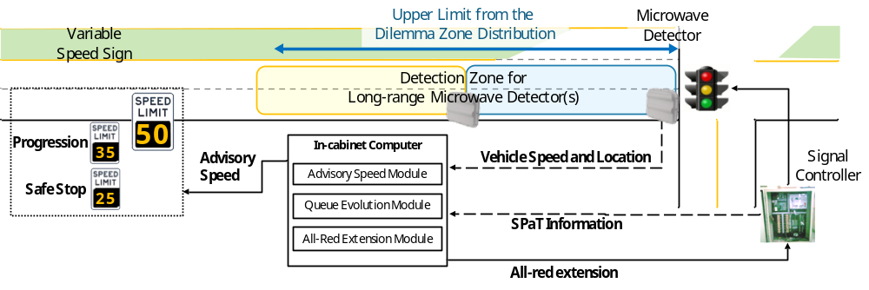
Integration of dilemma zone protection with speed harmonization
To improve the operational efficiency and safety
  All-red extension to red light running vehicles
  Advisory speed to ensure safe stop and smooth progression

Slide 2
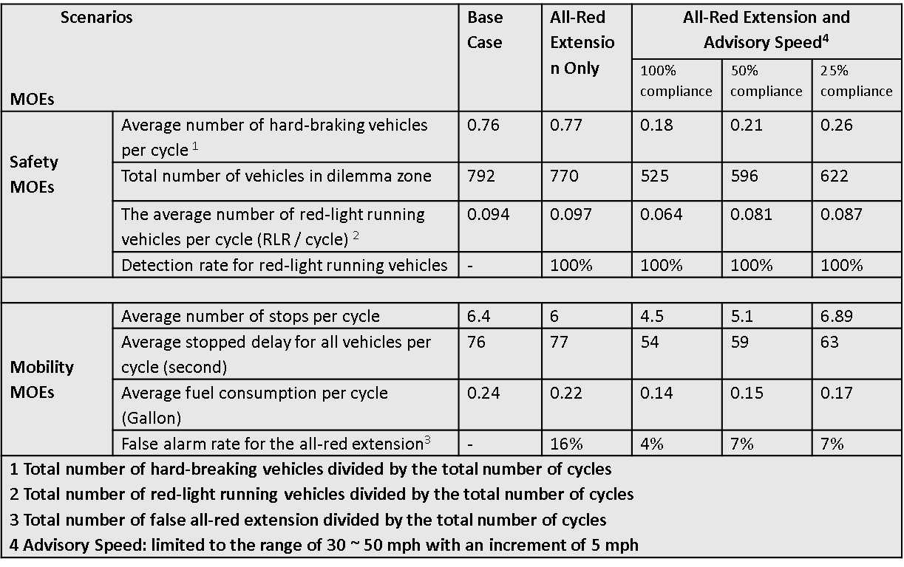
Conclusion
The all-red extension module can effectively provide protections to red-light running vehicles
The advisory speed module can reduce the number of vehicles trapped in the dilemma zone and minimize potential rear-ended crashes
The intersection mobility can be improved with the smoothed traffic propagation,

